Slide 1
Encrypted traffic classification – image based
By Shachar Ketz – 208968362
David Stern – 315556308
Chanan Helman – 209324102

Slide 2
Research Question: FlowPic Speed vs. Accuracy
Our research question focusing on the FlowPic article of encrypted traffic classification, by image representation.
We’re trying to take that model and to study and improve the tradeoff of the classification speed against the accuracy precent.
Ideal – we’ll want the model that also work fast and have the highest accuracy

Slide 3
FlowPic – Simple explanation
The FlowPic idea was created by Tal Shapira and Yuval Shavitt.
We dividing the flow into 60 second for each image, and creating a picture of Size X Time.
Each image is 1500X1500, because most of the packet's sizes are not over that number
By representing the traffic as an image, we can use image processing and deep learning tools for classification such as ‘CNN’
We’re trying to identify patterns in the pictures is each traffic type (Chat, video, voip, etc…)
https://ieeexplore.ieee.org/document/9395707

Slide 4
FlowPic improve – article suggestions
We made no effort to work optimize the CNN architecture, and simply used one that is known to well for image recognition.
Examining other known architectures may improve results, or simplify the training process.
We can also optimize our CNN by changing hyper-parameters such as the number of layers, layer sizes, activation functions, etc.
Furthermore, we can also reduce run-time and memory consumption by playing with input parameters like block length and the resolution of the number of bytes in a packet.
Furthermore, we can also reduce the number of bits per pixel by using binning.
At the extreme we can use a single bit per pixel creating binary images, such that black pixels represent an arrival of at least one packet with the corresponding size at the corresponding time interval.

Slide 5
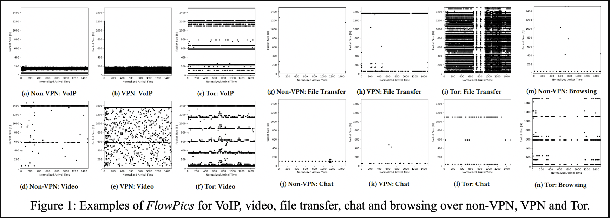
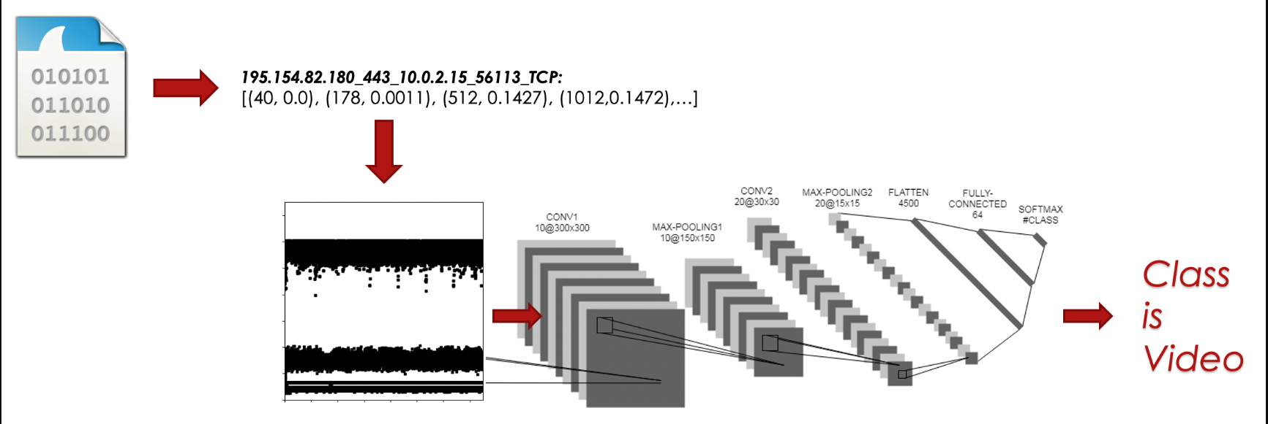
Examples

Slide 6
Our research – Speed vs. Accuracy
In our research we’re trying to take this model and to study the speed of the whole process and classification vs. the accuracy of it
For that we had to understand the FlowpPic work and code to try and improve it.
We worked on the dataset of “vpn non-vpn iscx 2016” in the article they also worked on the same dataset.
We’ve focused on several experiments to answer our question for each encrypted type.

Slide 7
Experiments
1) Checking the regular model 60 seconds each image 1500X1500
2) Then same, but now each imaged is according to 10 seconds and 30 seconds (giving us bigger dataset, but less information in each image, and bigger preprocessing time)
3) Creating images with overlap, 25% first second of the previous image, and 75 % of the new (according 60 seconds), and the opposite.
4) Giving weights to the classes (smaller sampled class will weight more)
5) Adding to the image another feature of direction (Client – White, Server – Gray)
6) Using ML algorithms instead of deep learning (based on work that Tal Shapira gave us), https://www.kaggle.com/code/guillaumefraysse/ucdavis-quic-data-exploration

Slide 8
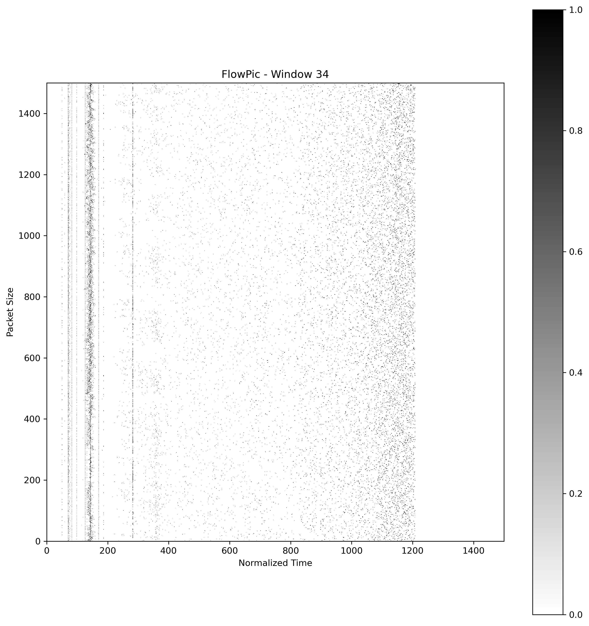
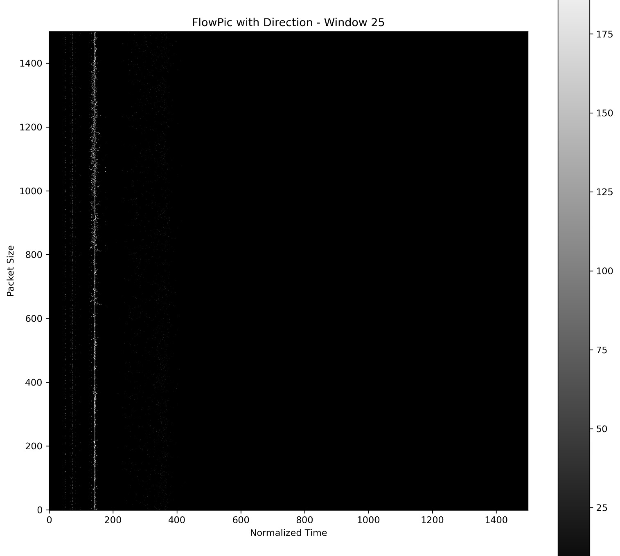
Our FlowPics
Left – video, right – voip + direction

Slide 9
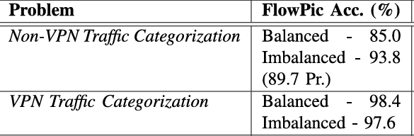
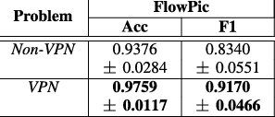
Article results
Inference – “While our 15 seconds classification time is certainly not problematic in most cases, it may still be a limiting factor for some applications. Thus, an interesting research direction would be to look for methods that would produce a faster classification. While there are already several published solutions, we believe there is still room for improvement”.
Accuracy –

Slide 10
Preprocessing
We got our data in ‘pcap’ files and we extracted from there into ‘csv’ format the: ‘Timestamp, Source/Destination port and ip and size.
Then we’ve combined for each type of class it’s whole data (Chat, video, file transfer and voip)
Then we’ve created and images and saved them as ‘npy’ files so we can represent the image as a matrix to work with, and labeled each class 0-3, and merged them into one big dataset
We split our data into train, test validation, so we can have “test” and “inference” when we have the in the test and validation same numbers of examples.
Findings: The whole preprocessing of the data can take a lot of hours (5 hours or even more) or even days for each experiments. Even if we have a trained model and we only need to do the inference, it can take few hours (around 4-6) just to get the data in the suitable format

Slide 11
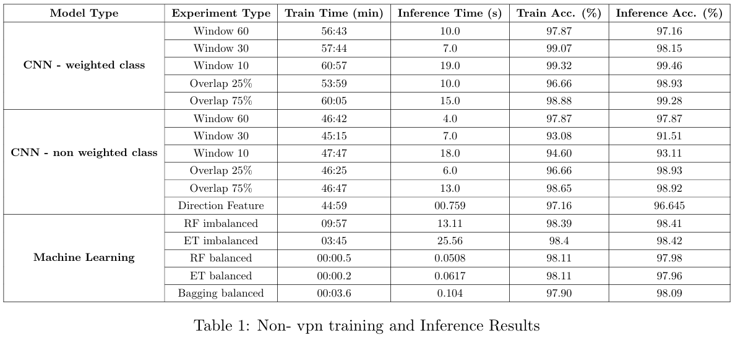
Finding and results
Non-vpn

Slide 12
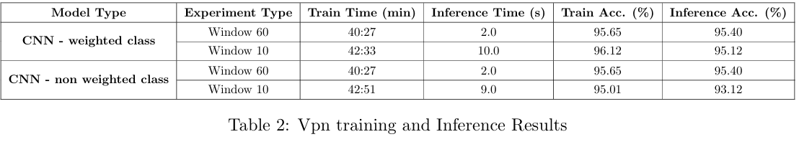
Finding and results
Vpn

Slide 13
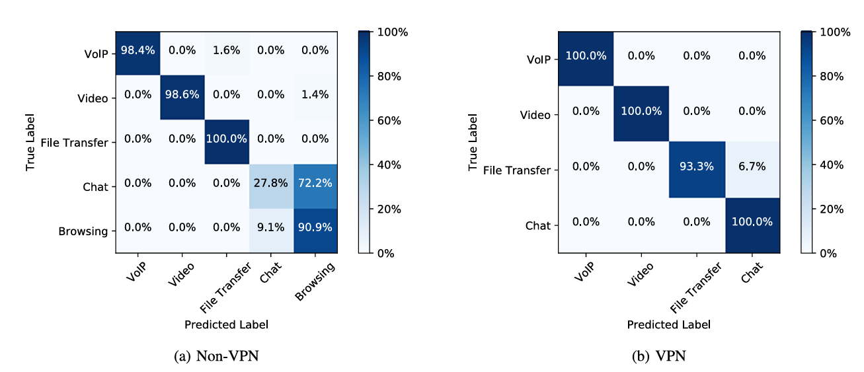
Confusion matrix
Article confusion matrix

Slide 14
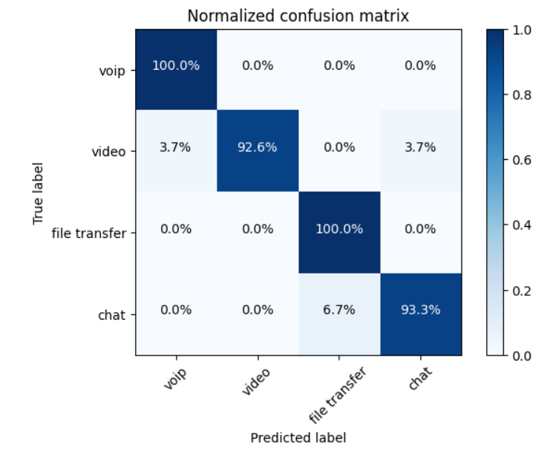
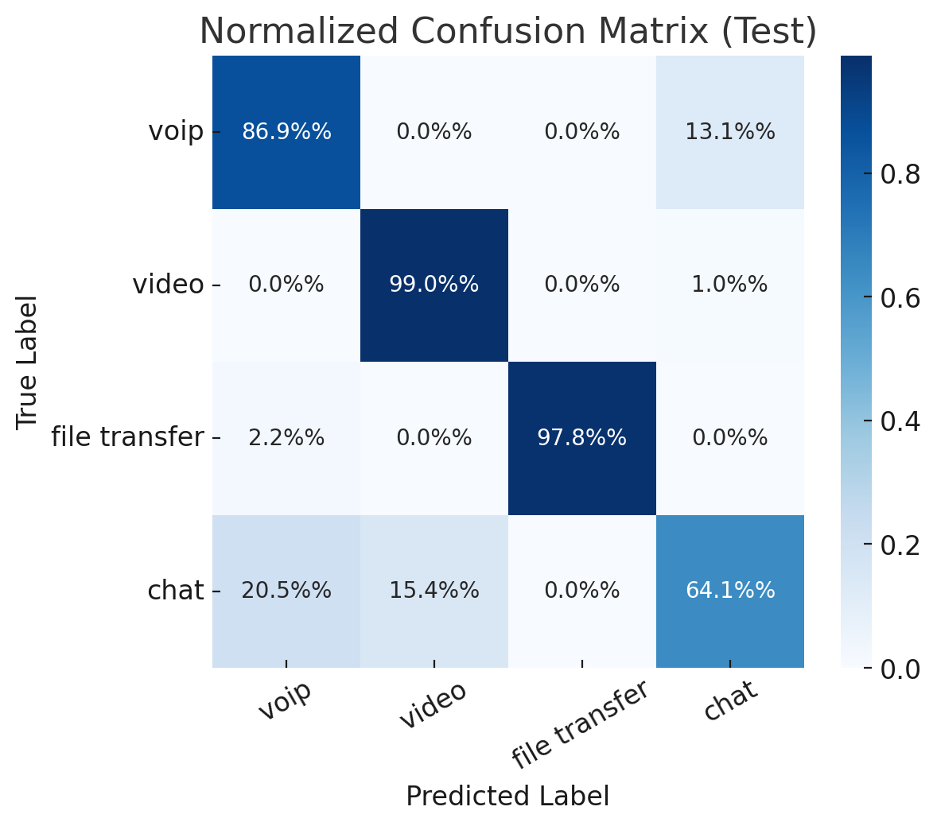
Confusion matrix
Our confusion matrices
No weight Window 60 non-vpn
No weight Window 10 vpn

